Slide 1
Survey on the COVID-19 impact on research
From the CRSCAA

Slide 2
Background
At the start of Fall 2020, the CRSCAA was wondering what it can do to help researchers at NJIT. This survey was the result of our discussion, and the results may be used to better inform areas/people in need of attention.
The questions were broken into two sections:
Research productivity
Research administration
We have 4 filters to look for problem areas in the data:
Tenure status, gender, years at NJIT, department
Initially our focus was placed on what we considered the most vulnerable population, tenure track faculty

Slide 3
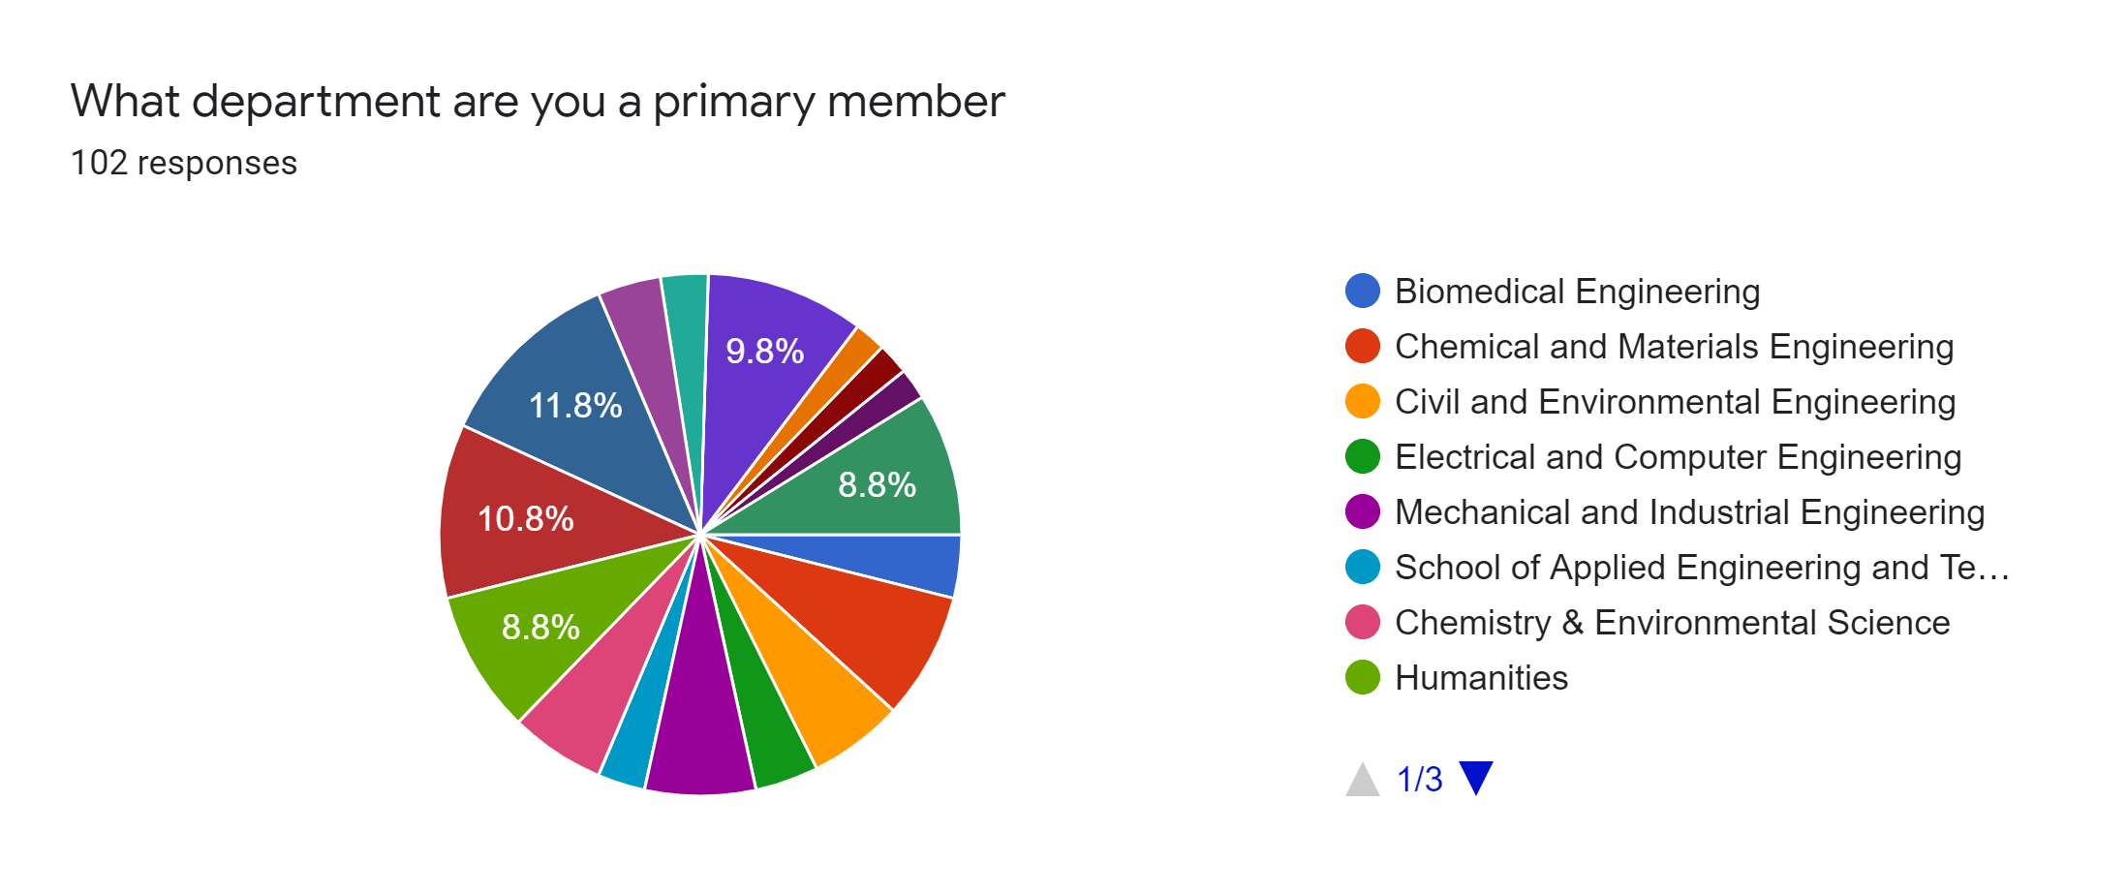
A wide range of faculty responded, with roughly a 30% response rate

Slide 4
The good news where NJIT is doing great
Research productivity
Faculty feel PPE is widely available (72% are above neutral)
Research supplies are generally available (nuts, bolts, chemicals, etc., 70% are above neutral)
Research Administration
Pre- and Post-Award in the research office are essentially unaffected by the pandemic -- they have done a really good job keeping business as usual (83% or pre-award and 89% for post-award are above neutral)

Slide 5
Some initial insights on areas of concern
Family care
Emotional well being
New graduate students
Financial constraints on external funding

Slide 6
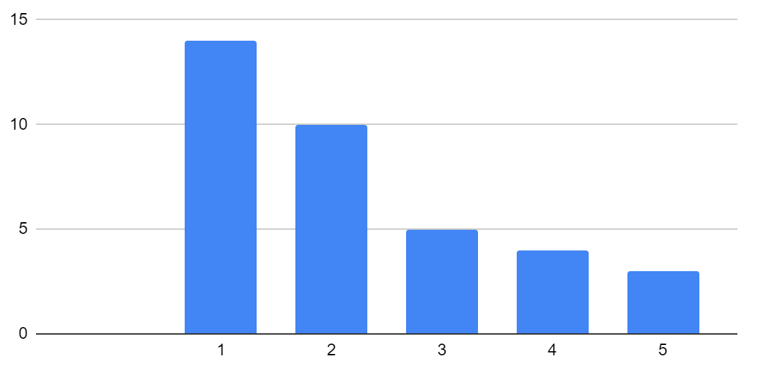
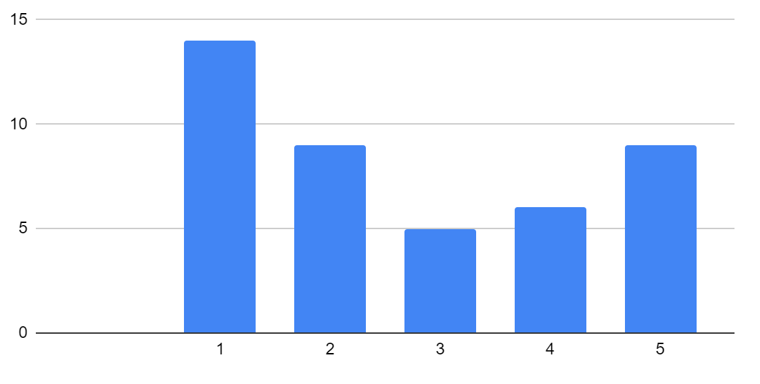
Are COVID related circumstances hindering your research group productivity (e.g., childcare, family care, etc.)?
# of Respondents
# of Respondents
Large Impact
No Impact
Large Impact
No Impact
Tenure Track
Tenured
COVID related circumstances hindering research group productivity
2.51/5 overall 1.78/5 for women and 2.80/5 for men

Slide 7
Are COVID related circumstances hindering your research group productivity (e.g., childcare, family care, etc.)?
# of Respondents
# of Respondents
Large Impact
No Impact
Large Impact
No Impact
Tenure Track
Tenured
All responses from female members were in categories 1 through 3

Slide 8
Are COVID related circumstances hindering your research group productivity (e.g., childcare, family care, etc.)?
“Childcare is the single biggest COVID-19 related issue impacting my research. You cannot do research while simultaneously caring for young children. Even as child care facilities have opened, they have done so with reduced hours to accommodate COVID-19 protocols, meaning I have less hours each day to do research. …..”
“It would be great if the university consider the situations of female faculties with infants/toddlers who are at home and require full attention. Babysitting is a full time job and the only option that female faculty have during the pandemic and it leaves little to no time for the mothers to do research.”
“In my opinion, the main issue we are facing is trying to juggle our family responsibilities while keeping the high standards of our very demanding job. For most of us this means working at night when the kids and family are sleeping, working weekends, basically not having a single day off since early March, and still struggle to keep the same productivity as pre-covid.”

Slide 9
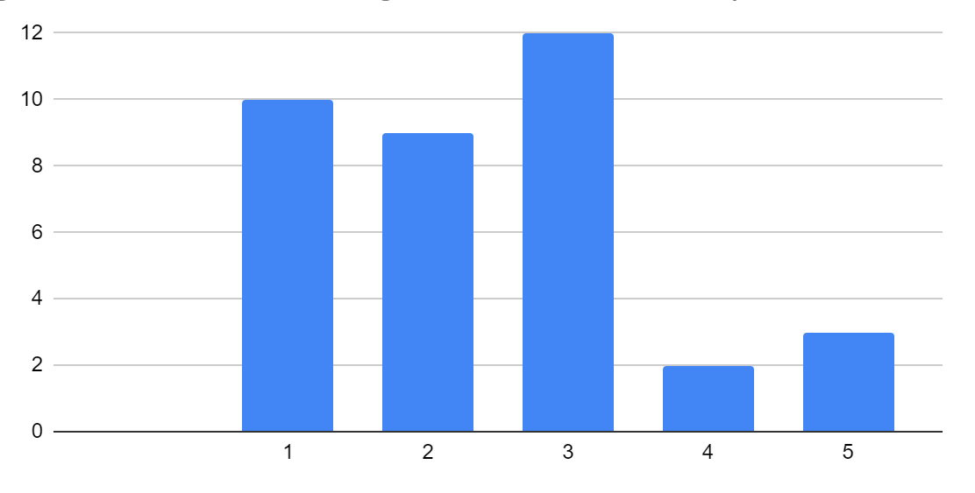
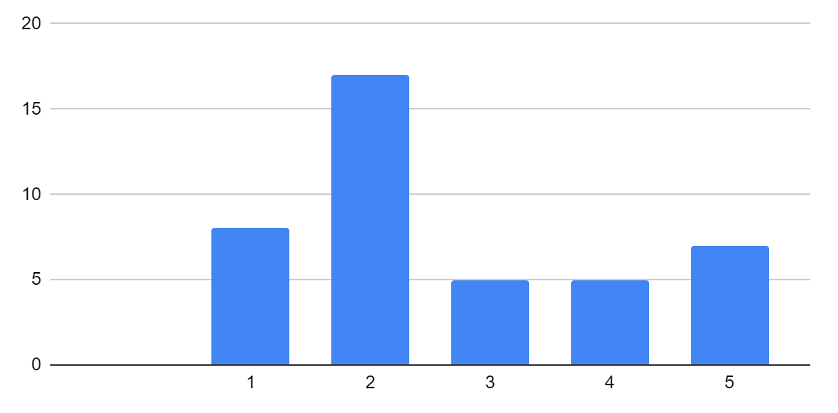
Has your research group experienced cognitive/emotional challenges that have affected productivity? (e.g., ability to focus)
# of Respondents
# of Respondents
Large Impact
No Impact
Large Impact
No Impact
Tenure Track
Tenured

Slide 10
Has your research group experienced cognitive/emotional challenges that have affected productivity? (e.g., ability to focus)
“Even though NJIT allowed 1-year extension on tenure cycle, the same was not applied to start-up funds which is causing a lot of issues and anxiety. The faculty senate should consider recommending 1-year extension of start-up funds for new faculty.”
“I'm very concerned by the lack of concern shown by my department chair and NJIT administration on how COVID-19 has affected me personally, my research, and my progress towards tenure. In the eight months since the pandemic began, I don't think I've ever heard my chair or an administrator reach out and ask how I'm doing and what resources would help me succeed….”

Slide 11
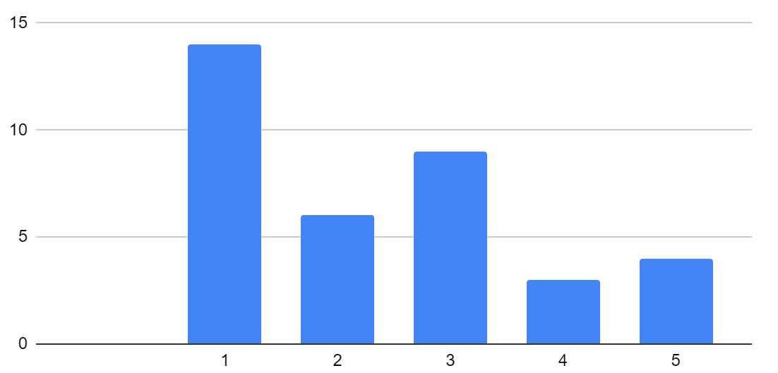
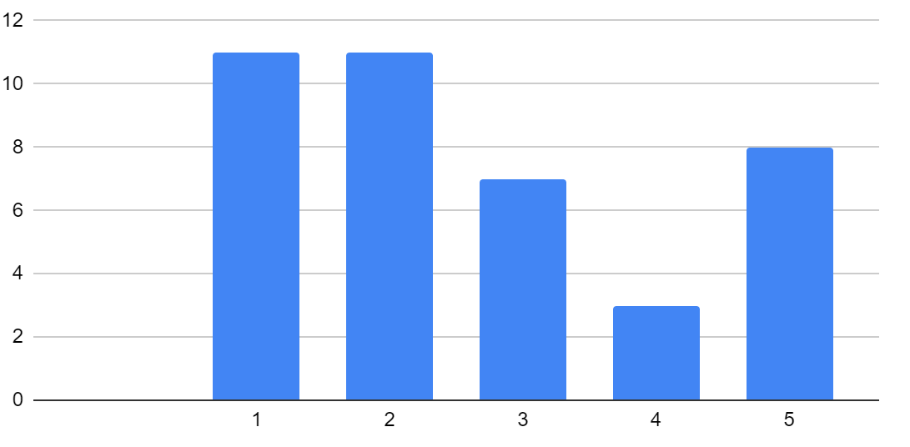
Is the availability of new students hindering your research group productivity?
# of Respondents
# of Respondents
Large Impact
No Impact
Large Impact
No Impact
Tenure Track
Tenured

Slide 12
Is the availability of new students hindering your research group productivity?
“It is very hard to find qualified graduate students for research. There are not enough qualified domestic students, and it is competitive to get these students at NJIT. The visa situation is horrible even if find a qualified international student. This is becoming the biggest hurdle for many researchers at NJIT.”
“Lack of incoming graduate students and visa issues for our graduate students from overseas are huge problems. It will be very important to take some steps to address this before next fall.”

Slide 13
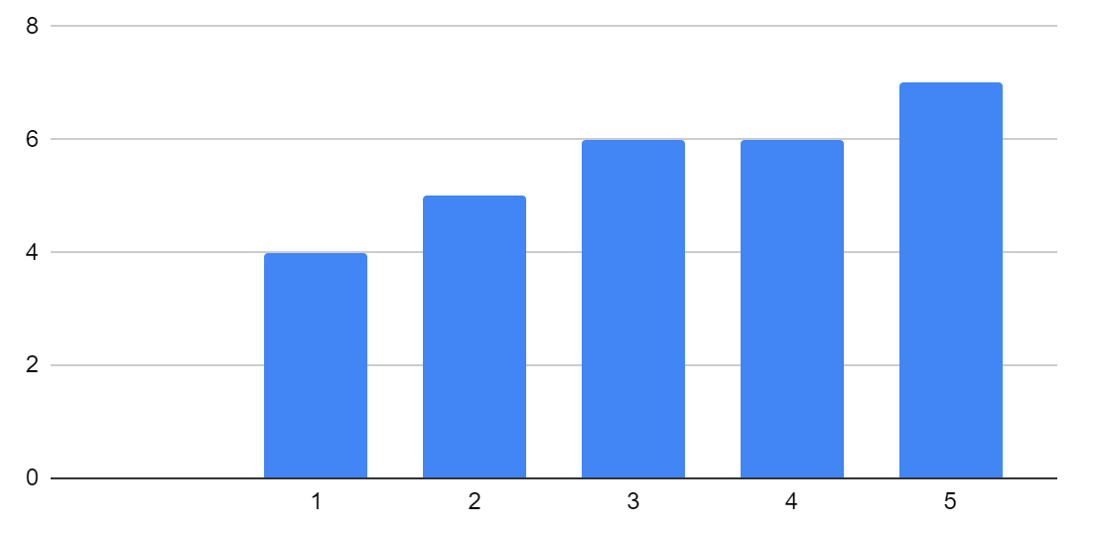
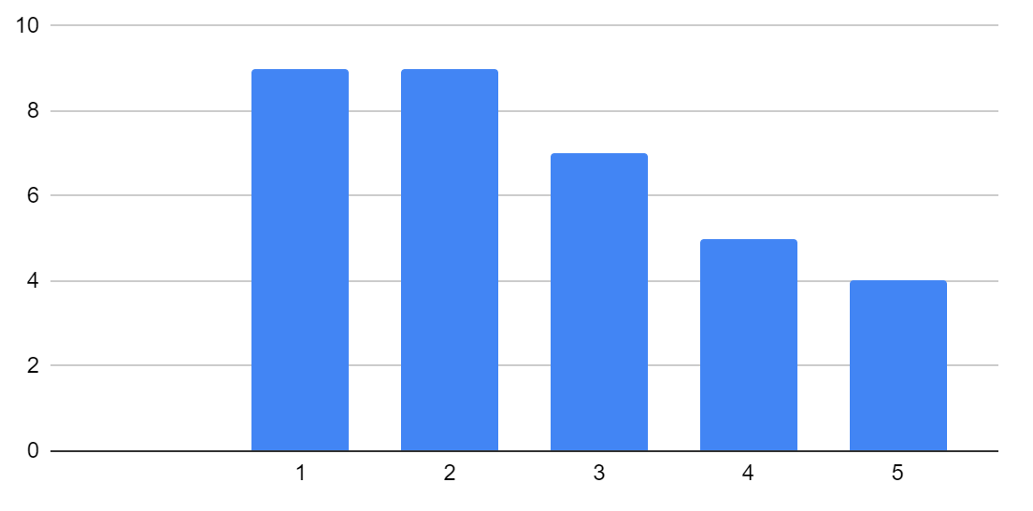
Is the pandemic causing budget or financial constraints on your external sponsored research projects?
# of Respondents
# of Respondents
Large Impact
No Impact
Large Impact
No Impact
Tenure Track
Tenured

Slide 14
Is the pandemic causing budget or financial constraints on your external sponsored research projects?
“... I have had to abandon some ongoing research because of the pandemic. Research funding from a major donor has been scaled back, we do not know to what extent yet, but we have been told 15-25%. A second project was in the works for getting approval releasing an RFP, which has now been canceled. All told this will probably be about $150,000-$175,000 in lost funding. ...”
“I have funds budgeted in grants for travel and cannot spend them due to COVID-19. So, it's really negatively affecting my research expenditures….”

Slide 15
Future outlook
Summary
The CRSCAA has made some initial headway in interpreting the data from the survey, but other areas can be looked at
Our initial analysis shows:
Untenured faculty are struggling and have concerns beyond the one year extension
Women (both tenured and tenure track) are taking on childcare responsibilities at a higher rate than men
There is less external funding and those with grants are stretching their budgets
Attracting new graduate students is a concern faculty alone cannot typically handle
Feedback
Does the Faculty Senate have any feedback or specific areas that should be considered more closely?

